Slide 1



Music Store Analysis
SQL project to analyze online music store data
- Vaibhav Nikam

Slide 2


Objectives
Analyze a music sales dataset to identify the most senior employee, top countries by invoice count, highest total invoice values, optimal city for a promotional Music Festival, best customer based on spending, retrieve Rock Music listeners' details, invite top rock bands, list tracks longer than average, calculate customer spending on artists, determine popular music genres by country, and identify top-spending customers per country.

Slide 3
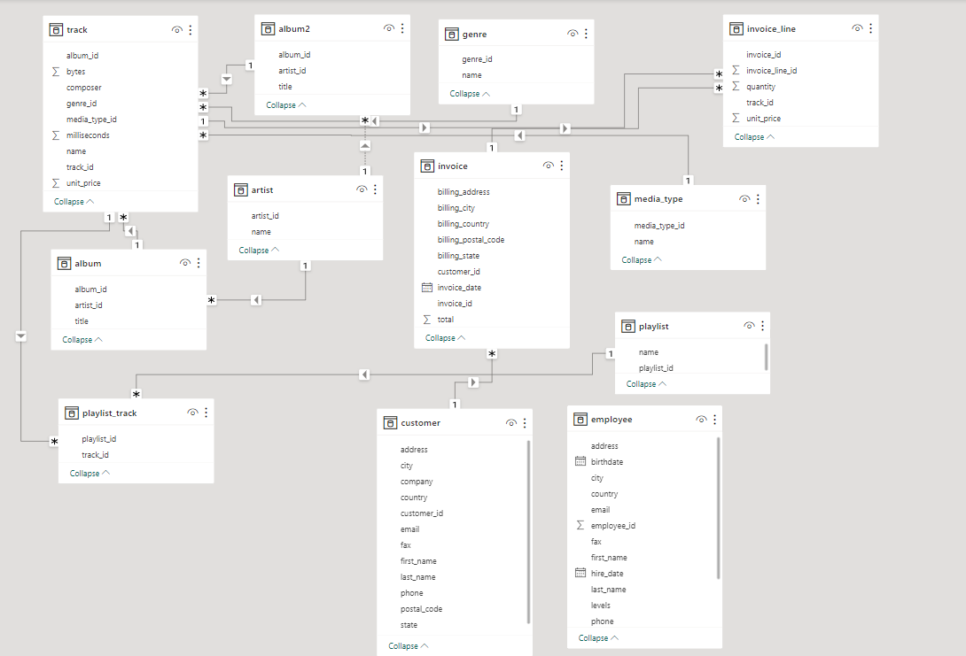

Schema :

Slide 4
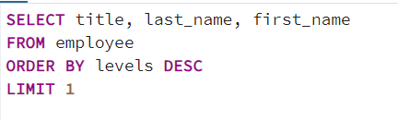

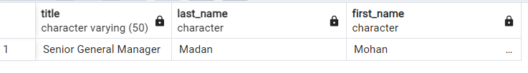

Who is the senior most employee based on job title?

Slide 5
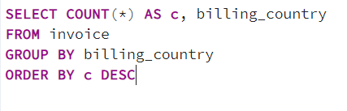
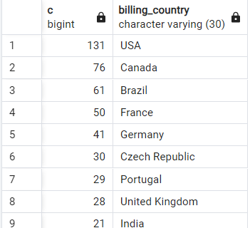
Which countries have the most Invoices?

Slide 6
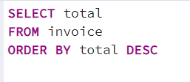
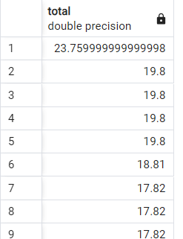


What are top 3 values of total invoice?
.

Slide 7

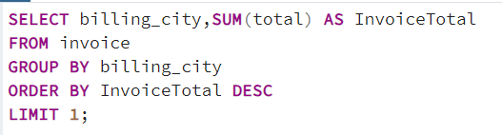
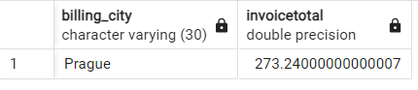

Which city has the best customers? We would like to throw a promotional Music Festival in the city we made the most money. Write a query that returns one city that has the highest sum of invoice totals. Return both the city name & sum of all invoice totals

Slide 8

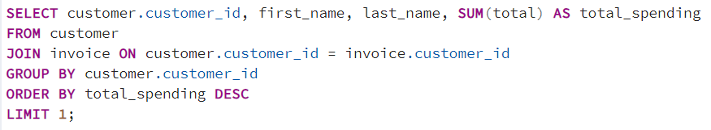

Who is the best customer? The customer who has spent the most money will be declared the best customer. Write a query that returns the person who has spent the most money

Slide 9
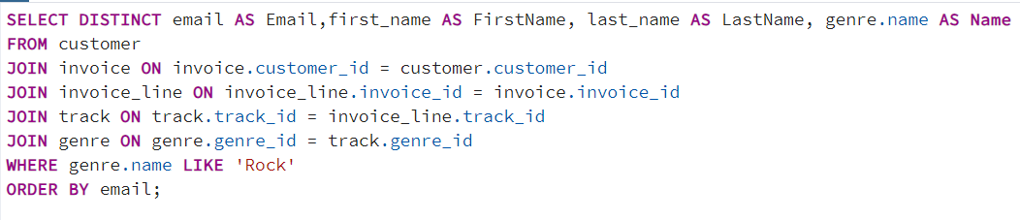
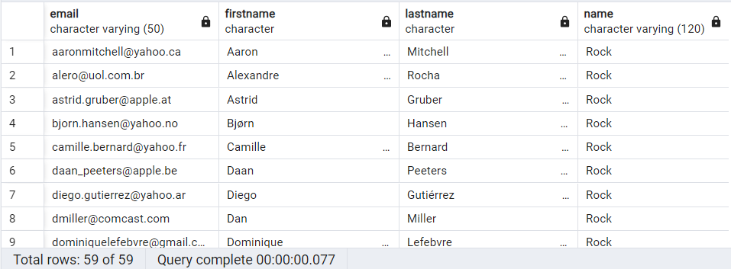
Write query to return the email, first name, last name, & Genre of all Rock Music listeners. Return your list ordered alphabetically by email starting with A

Slide 10
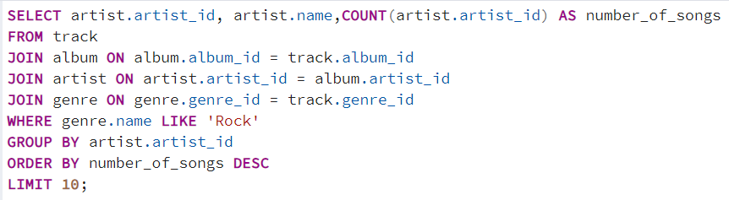
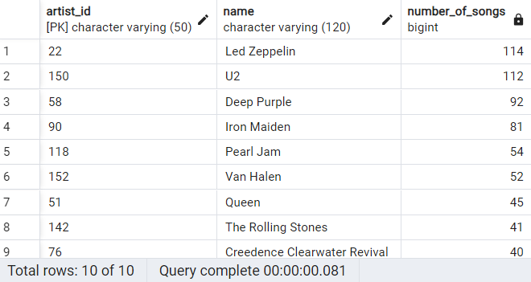
Let's invite the artists who have written the most rock music in our dataset. Write a query that returns the Artist name and total track count of the top 10 rock bands

Slide 11
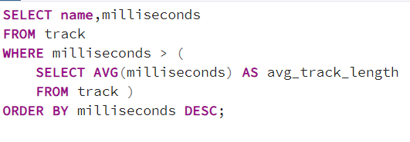
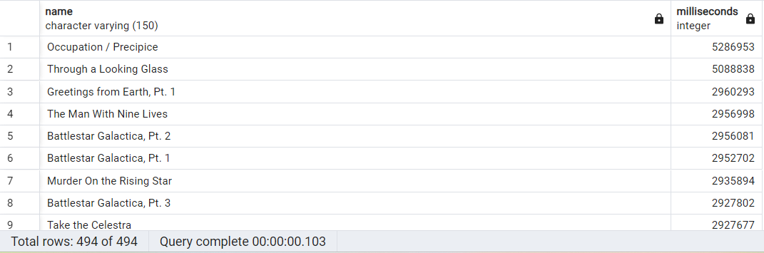
Return all the track names that have a song length longer than the average song length. Return the Name and Milliseconds for each track. Order by the song length with the longest songs listed first

Slide 12
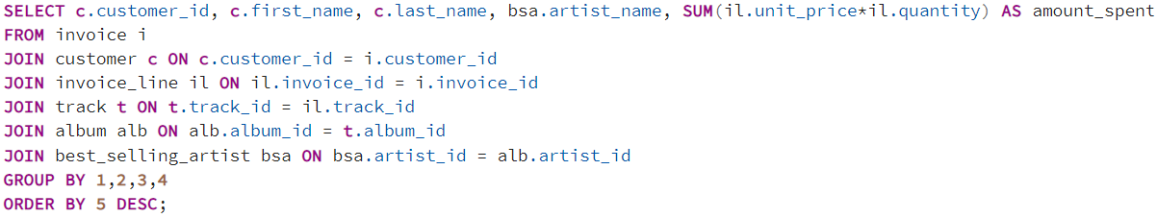
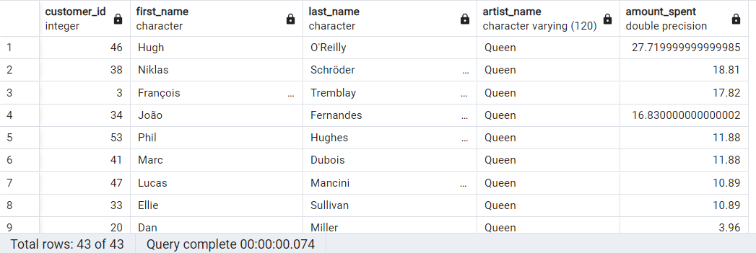
Find how much amount spent by each customer on artists? Write a query to return customer name, artist name and total spent
.

Slide 13
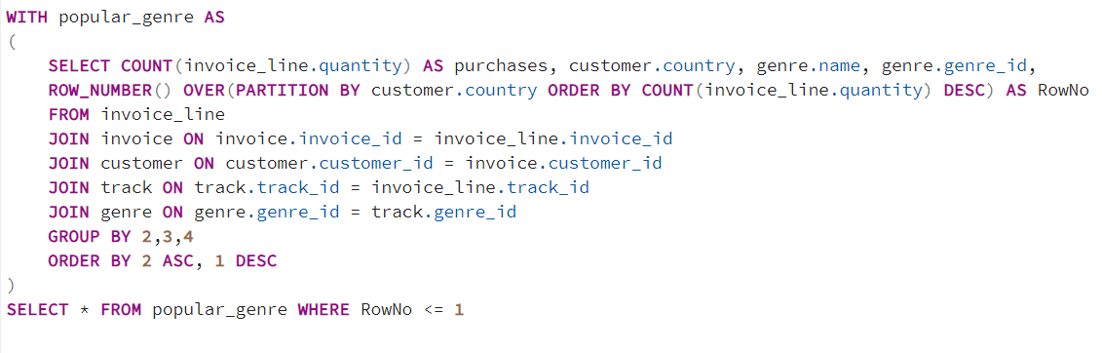
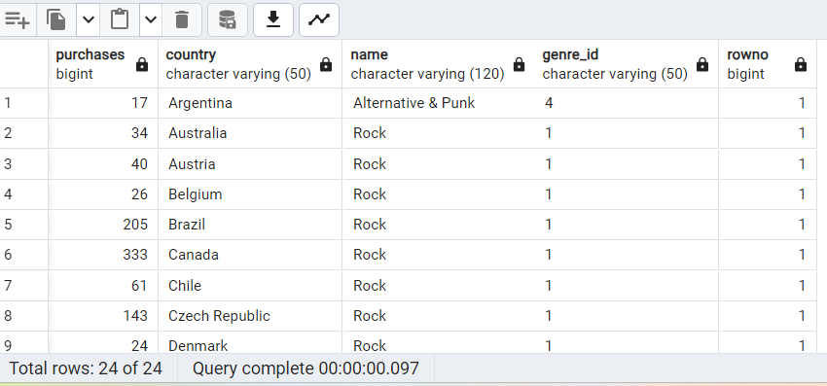
We want to find out the most popular music Genre for each country.

Slide 14
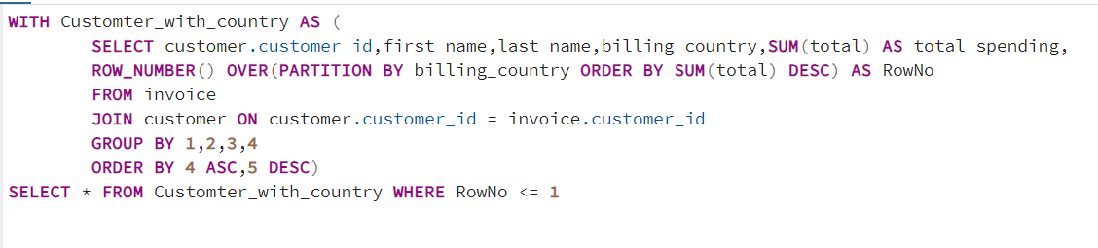
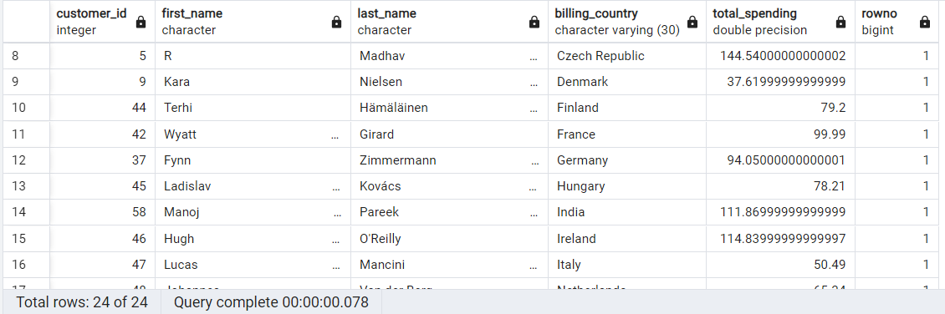
Write a query that determines the customer that has spent the most on music for each country.

Slide 15
Thank You!!!

